Slide 1


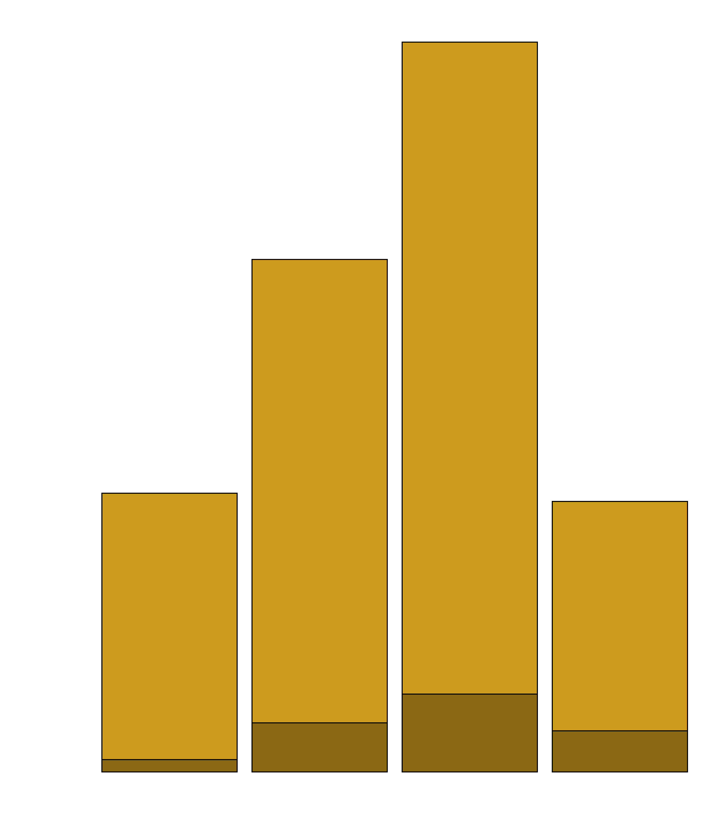
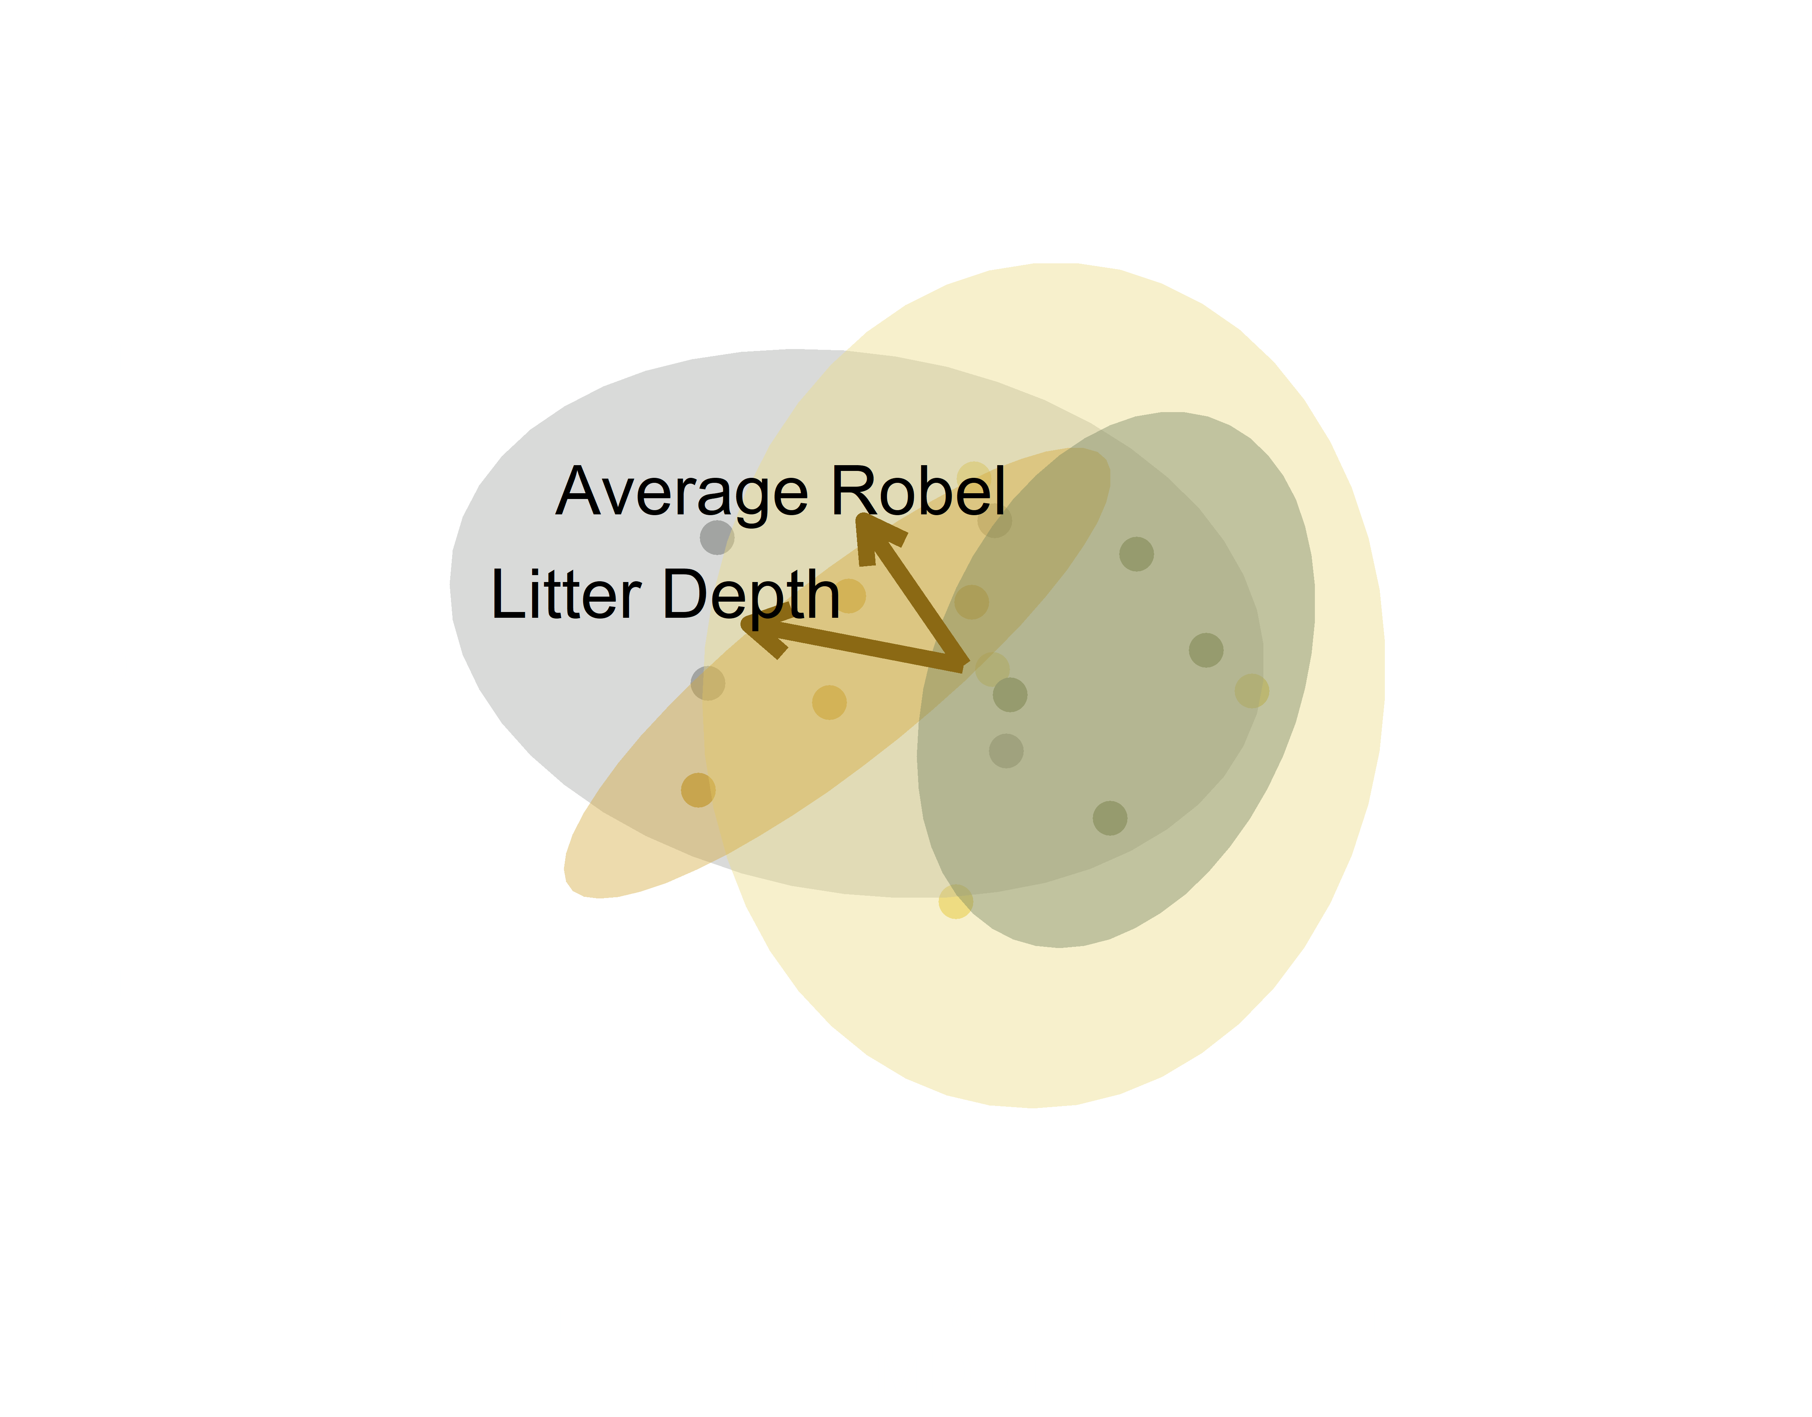

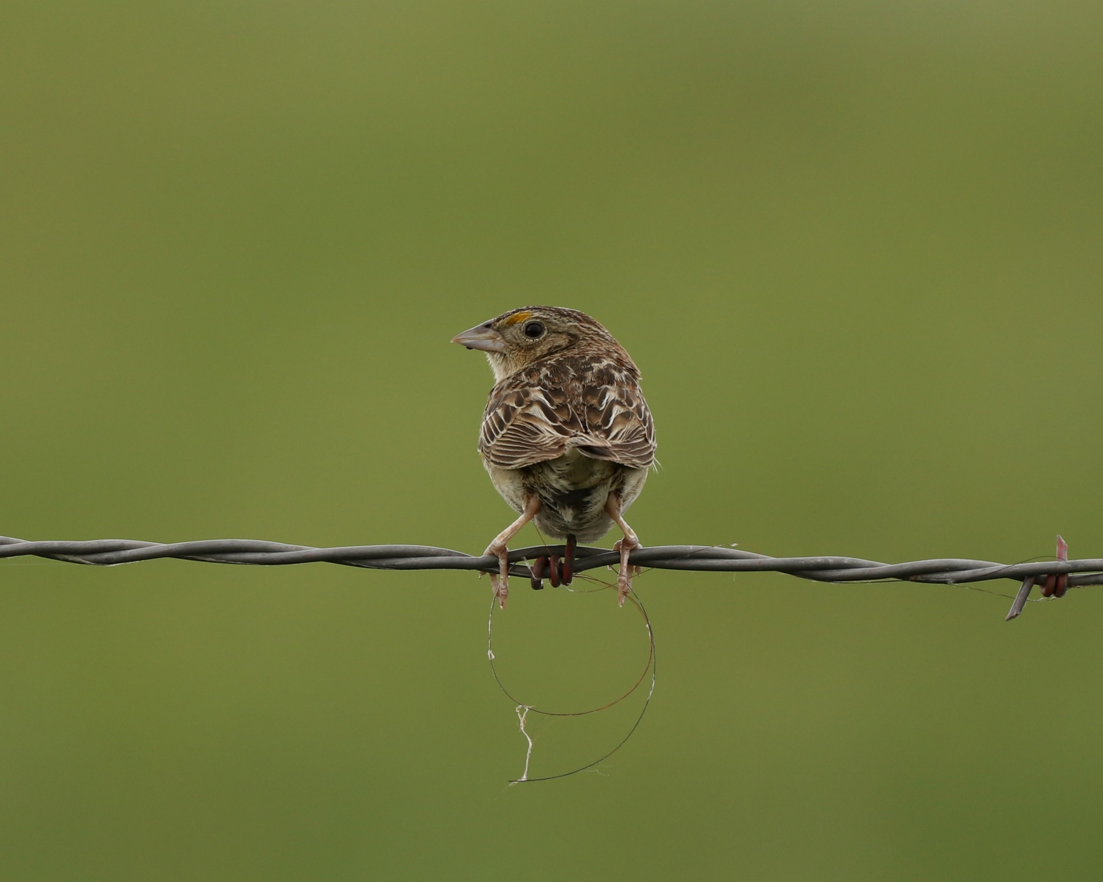
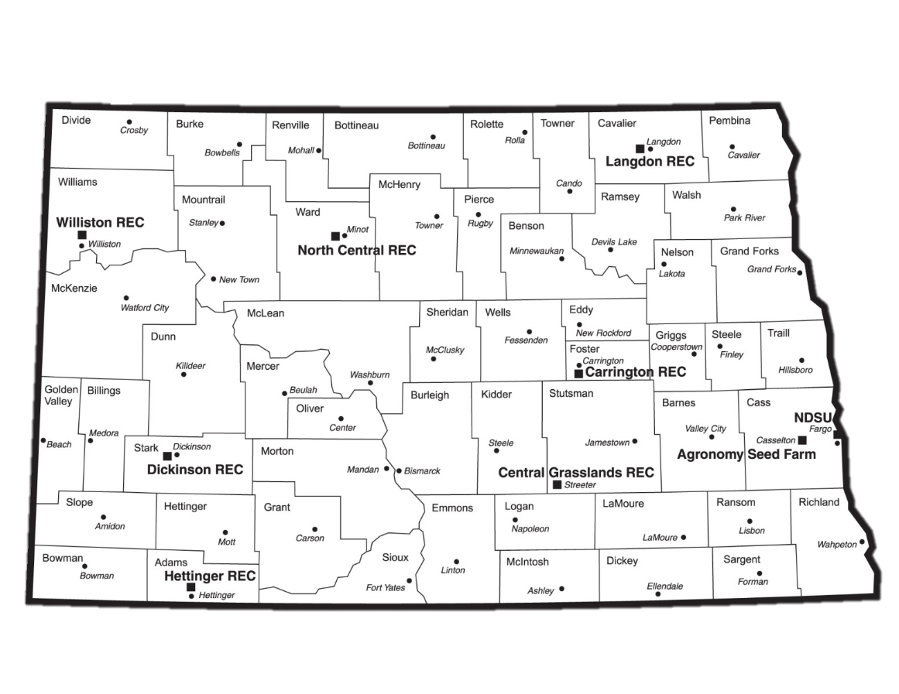
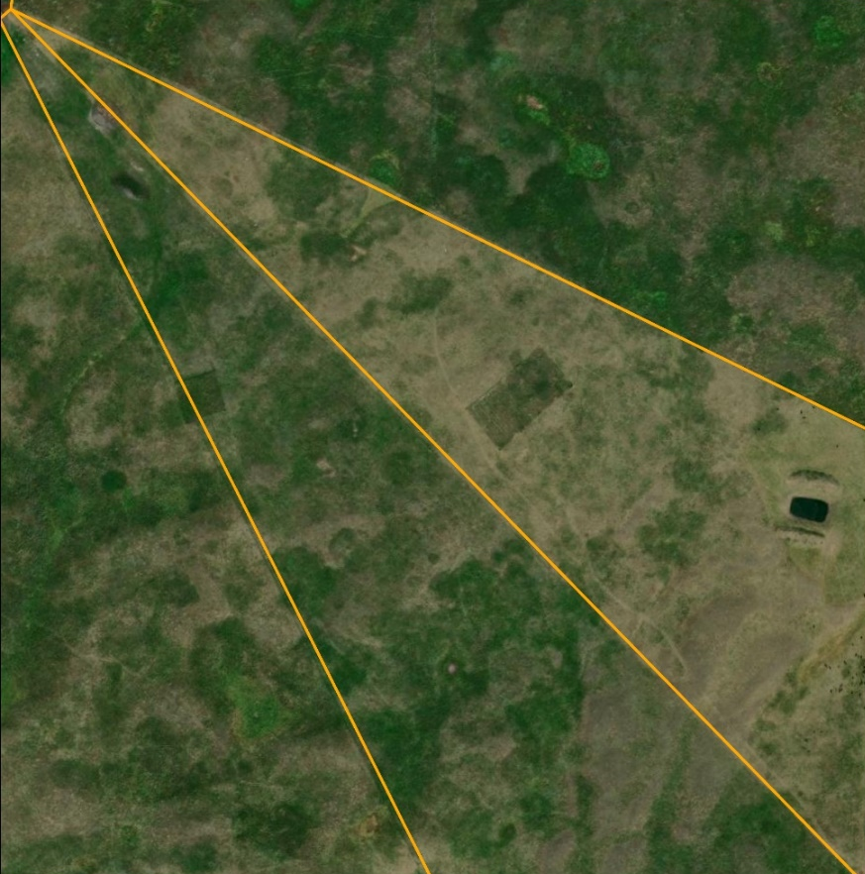

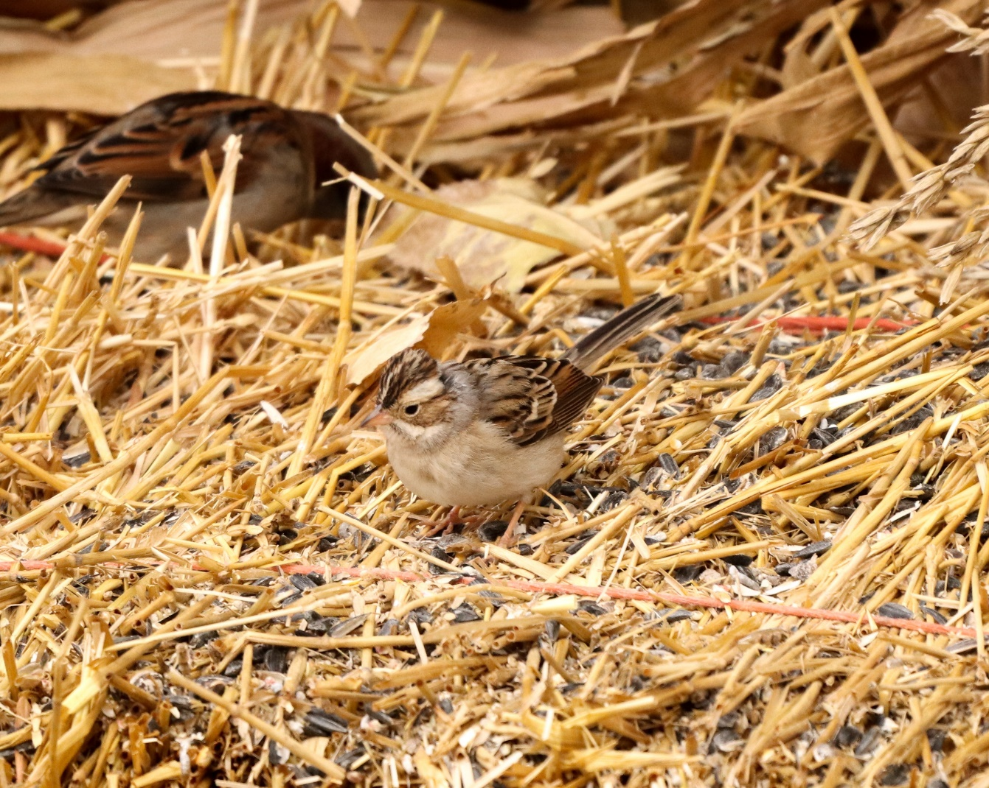
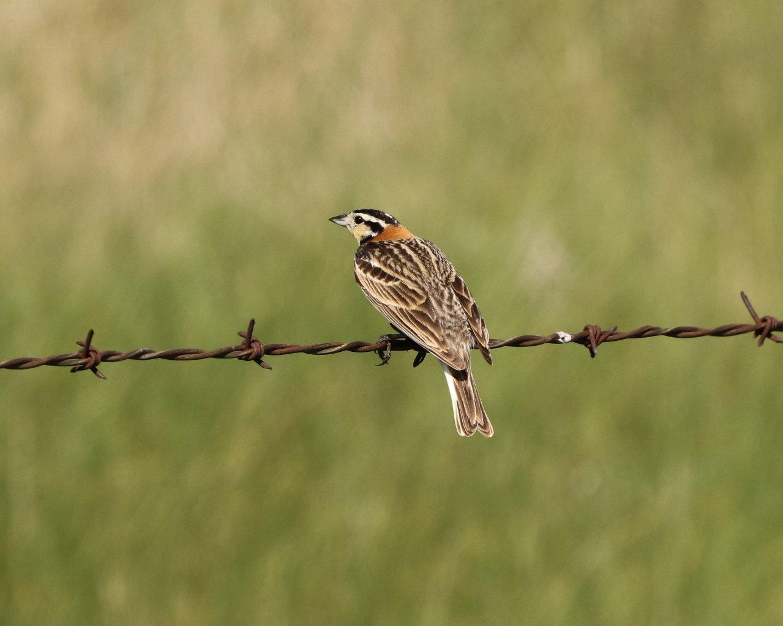
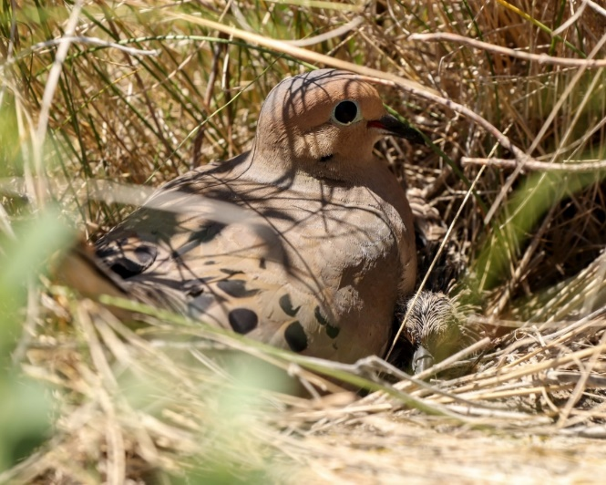
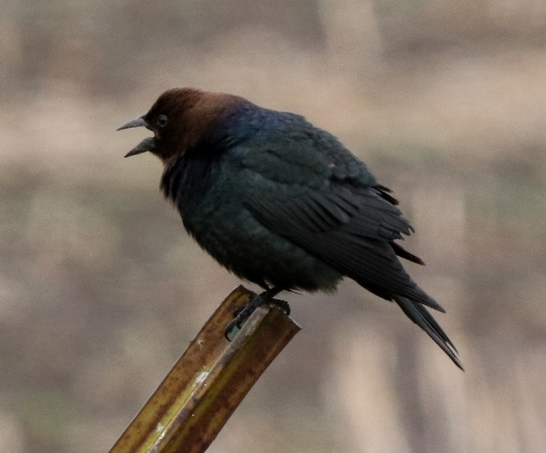
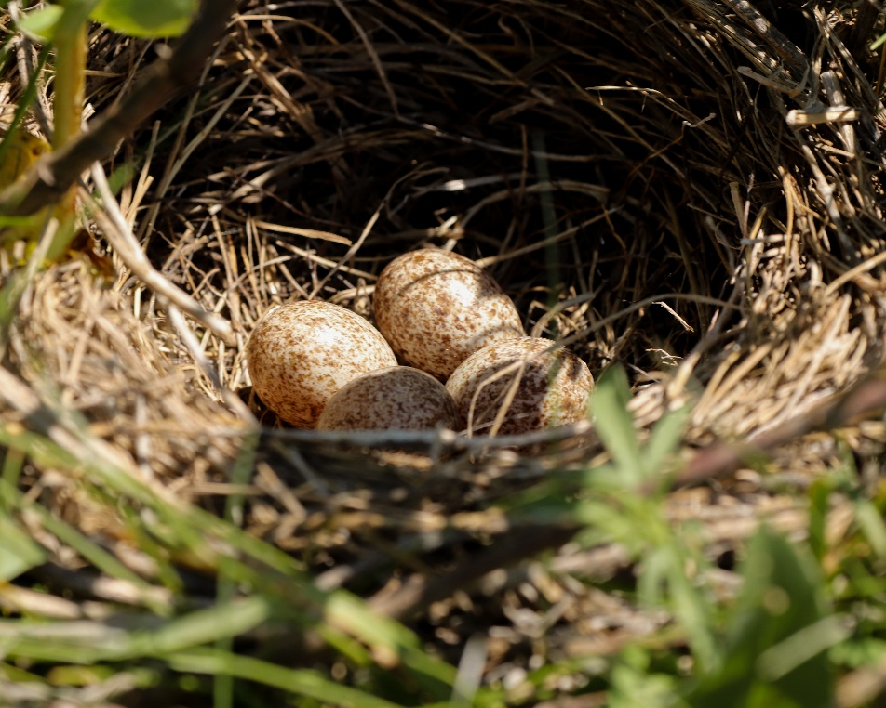
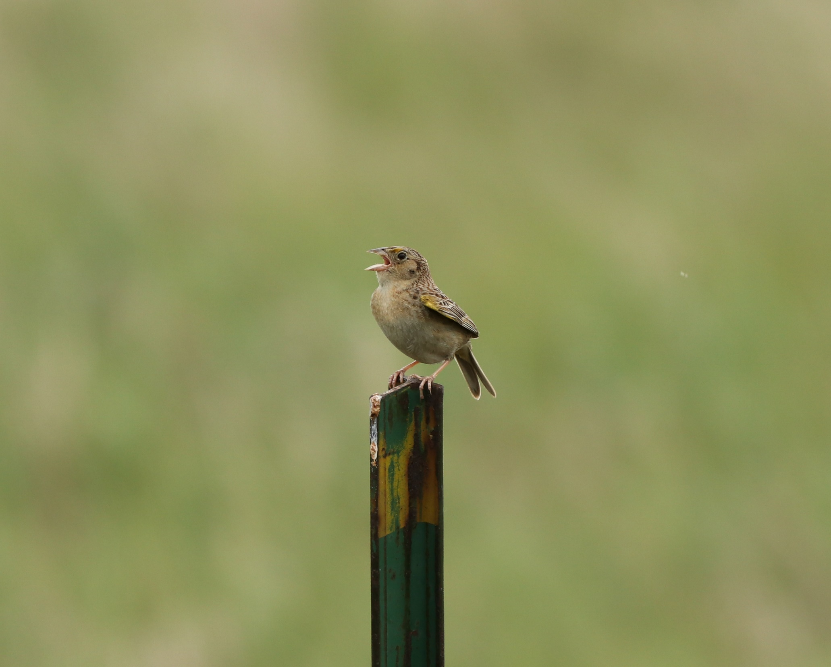


Breeding Bird Nesting Abundance and Nest Success in a Modified Twice-Over Rest-Rotation Grazing System
Justin Clarke¹, Torre Hovick¹, Kevin Sedivec^{1,2} , Ryan Limb¹, Jason Harmon¹, Ben Geaumont³
¹ School of Natural Resource Sciences, North Dakota State University, ² Central Grasslands Research Extension Center, ³ Hettinger Research Extension Center
BACKGROUND
Current grazing management in much of the Great Plains negatively influences avian diversity by creating homogenous landscapes through uniform grazing practices and altered or suppressed fire regimes.
Research has shown that restoring disturbance regimes can increase heterogeneity which increases avian biodiversity.
Fire and grazing interactions are effective at establishing heterogeneity, but many regions have a cultural aversion to fire which requires creative management practices to restore heterogeneity.
RESULTS
Avian Nesting Abundances
Avian Nesting Community
Vegetation Structure
Heavy
FAC
Full
OBL
Moderate
Rest
RESEARCH QUESTION
Can a modified twice-over rest-rotation grazing system create vegetation structural heterogeneity that benefits obligate grassland birds?
METHODS
Modified Twice-Over Rest-Rotation Grazing System
Pastures are divided into four paddocks based on utilization.
Rested (21 months of no grazing, 0% utilization)
Moderate Intensity (20-40% utilization)
Full Intensity (40-60% utilization)
Heavy Intensity (60+% utilization)
Stocking rates were maintained at ~2.76 AUM/ha.
Nest Dragging
We conducted nest drags from late-May to mid-July.
We used a 30 m rope with cans tied every 5 m.
We dragged each paddock 4 times.
Nest Monitoring
We monitored nests every 2-4 days until fate was determined.
Successful nests fledged at least one conspecific individual, determined by either resighting a fledging or using adult behavioral indicators.
Vegetation Sampling
We measured vegetation structure along three 25 m transects in each paddock.
We took Robel readings in each cardinal direction.
We measured litter depth in each quadrat.
This graph shows the number of facultative (FAC) and obligate (OBL) individuals nesting in each grazing intensity. Grouping is based on habitat preference.
The ordination compares avian nesting communities between grazing intensities where more distant points are more dissimilar. Vegetation structural measurements are overlaid; longer arrows indicate factors that more strongly differentiates grazing intensities. Ellipses show 95% confidence intervals There was no significant difference in avian communities between grazing intensities.
Group | Species | Nests
Facultative | 16 | 393
Obligate | 8 | 44
Total | 24 | 437
Grazing Intensity | Heavy | Full | Moderate | Rest
Proportion of Total Nests | 16% | 29% | 41% | 15%
Apparent Nesting Success | 22% | 26% | 30% | 26%
The top figure shows Robel measurements for each grazing intensity. The bottom figure shows litter depth measurements for each grazing intensity.
Number of avian species and nests divided into groups based on habitat preference.
The table shows the proportion of the total nests and apparent nesting success for combined species across each grazing intensity.
IMPLICATIONS AND FUTURE OBJECTIVES
Variation in grazing intensity alters vegetation structure and influences grassland bird nesting communities.
These results are preliminary and based on data collected during a period of extreme drought.
Research will continue for several years examining the impacts of a modified twice-over rest-rotation grazing system on nesting success.
Research will benefit obligate grassland nesting species that are currently listed as species of concern including grasshopper sparrow, chestnut-collared longspur, Northern pintail, upland sandpiper, and bobolink.
Contact Information
justin.r.clarke@ndsu.edu
Scan the QR code for references and additional information

